Slide 1

Information Retrieval Chapter 6: Text Categorization and Filtering TY B.Sc. (CS)
Semester VI
Poornima .N
Assistant Professor, Department of IT/CS
1

Slide 2

1 Topics:
Text classification algorithms:
Naive Bayes
Support Vector Machines
Feature selection and dimensionality reduction
Applications of text categorization and filtering
“Can we trust a search engine just because it gives us fast results — or do we need evidence?”

Slide 3
2 Text Classification – Introduction
In traditional search, users perform ad hoc retrieval (one-time queries) • Some information needs are ongoing and repetitive • Example: Daily tracking of news on multicore computer chips

Slide 4
Standing Queries
Standing Query • A saved query that runs periodically on new documents • Used to automate repetitive searches
🧠 Example:
multicore AND computer AND chip

Slide 5
3 Limitations of Standing Queries
⚠️ Simple queries miss relevant documents
Reasons: • Different terms express same concept •
Example: processor, microprocessor, multi-core
➡️ Leads to low recall

Slide 6
3 Refining Standing Queries (Rule-Based Classification)
Improved query using Boolean rules:
(multicore OR multi-core)
AND
(chip OR processor OR microprocessor)
❌ Queries become complex over time ❌ Hard to create and maintain

Slide 7
3 Classification Concept
📂 Text Classification
• Task of assigning documents to predefined classes
Example classes:
• Documents about multicore chips
• Documents not about multicore chips
🔹 Also called:
• Routing
• Filtering

Slide 8
4 Importance of Text Classification
Text classification is used in:
• Spam detection
• Sentiment analysis
• Email sorting
• Content filtering
• Vertical search engines
➡️ Foundation for machine learning methods like Naive Bayes

Slide 9
7 MINI CLASSROOM EXERCISE 1
Exercise 1: Word-Based Classification (No maths)
Step 1: Give classes
Class A: Sports
Class B: Technology
Step 2: Give documents 1️⃣ “The team won the match” 2️⃣ “New processor improves performance” 3️⃣ “The player scored a goal”
Ask students:
“Which class will Naive Bayes choose and WHY?”

Slide 10
7 MINI CLASSROOM EXERCISE 2
Exercise 2: Word-Based Classification (No maths)
Words | Spam | Not Spam
free | yes | no
meeting | no | yes
offer | yes | no
Document:
“free offer”

Slide 11
4 Introduction to Naive Bayes
Naive Bayes Classifier
• A machine learning method for text classification
• Uses probability to decide the class of a document
• Learns from labeled training data

Slide 12
5 Intuition Behind Naive Bayes
Key idea:
• Certain words indicate certain topics
Examples:
• goal, match, team → Sports
• election, vote, party → Politics
➡️ Naive Bayes learns this using probabilities

Slide 13
5 How Naive Bayes thinks
“Naive Bayes asks one question: Which class is more probable for this document?”
For each class, it checks:
How often do these words appear in this class?

Slide 14
6 How Naive Bayes Works (High Level)
For a new document:
1️⃣ Look at the words in the document
2️⃣ Estimate how likely these words are for each class
3️⃣ Compute probability for each class
4️⃣ Choose the class with highest probability

Slide 15
6 Why is it Called Naive Bayes?
🔹 Bayes • Based on Bayes’ theorem (probability rule)
🔹 Naive • Assumes words are independent of each other
• This assumption is simple but effective

Slide 16
6 Why Naive Bayes is Popular
✅ Simple and easy to understand
✅ Fast and efficient
✅ Works well for large text collections

Slide 17
7 Bayes theorem
P(c | d) = P(d | c) × P(c) / P(d)

Slide 18
7 Naive Bayes
P(c | d) ∝ P(c) × ∏ P(wᵢ | c)

Slide 19
7 Text Classification Problem
Given:
Document space X
Set of classes C = {c₁, c₂, …, cⱼ}
Goal: Assign each document to exactly one class

Slide 20
7 Document Space (X)
“We are given a description d ∈ X of a document, where X is the document space.”
X (document space) = all possible documents the system can see
Each document d belongs to this space

Slide 21
7 Classes (C)
“A fixed set of classes C = {c1, c2, …, cJ}”
Classes = labels or categories
They are decided by humans, not the computer

Slide 22
7 Training Set (D) (Supervised Learning)
“We are given a training set D of labeled documents ⟨d, c⟩”
Training set = documents where we already know the correct class
Each document comes with a label

Slide 23
7 What does P(c | d) mean?
P(c | d)
“Probability of class c, given document d”
So Naive Bayes is asking:
“Given this document, how likely is it to belong to class c?”

Slide 24
7 What is P(c)?
P(c)
This is the prior probability of class c.
“How common is class c in training data?”
Example:
100 training documents
30 are China
P(China) = 30 / 100

Slide 25
7 What is P(d | c)?
“If the document belongs to class c, how likely is it to look like this?”
But documents are made of words, so…

Slide 26
7 Learning Method & Classifier (Γ and γ)
1️⃣ Learning method (Γ)
The process
The algorithm
Example: Naive Bayes learning method
2️⃣ Classifier (γ)
The result
The function that actually classifies documents.
γ : X → C

Slide 27
6 Naive Bayes – Probabilistic Model
📌 Goal: • Find the most probable class for a document
For a document d and class c:
➡️ Choose the class with maximum:
P(c | d)

Slide 28
8 Text Classification Problem Example
Document: "Beijing joins WTO"
Class: China

Slide 29


9 Classifier Function
Classifier (γ):
Meaning:
Input → Document
Output → One class
Example:

Slide 30
14 1. Examples
Imagine you are a Library Helper. Your job is to take a book and decide if it goes in the "Horror" section or the "Romantic Comedy" section.

Slide 31
14 1. The Starting Guess (The "Prior")
Before you even open the book, you look at the library. You notice that 80% of the library is Horror books.
In the formula: This is P(c). It’s the "Starting Score" based on what you already have.

Slide 32
14 2. The Clues (The "Evidence")
Now, you open the book and look at three random words: "Blood", "Shadow", and "Kiss".

Slide 33
14 2. The Clues (The "Evidence") with datasets
Word | Chance in Horror | Chance in Rom-Com
"Blood" | Very High (10 points) | Very Low (0.1 points)
"Shadow" | High (5 points) | Low (1 point)
"Kiss" | Low (1 point) | Very High (10 points)

Slide 34
14 3. The Math (The "Multiplication")
To find the final score, you multiply your Starting Guess by the word scores.

Slide 35
14 3. The Math (The "Multiplication") Horror Score:
Horror Score:
Start with 80 (because Horror is common).
Multiply by 10 (for "Blood").
Multiply by 5 (for "Shadow").
Multiply by 1 (for "Kiss").
Total = 4,000 points.

Slide 36
14 3. The Math (The "Multiplication") Rom-Com Score:
Rom-Com Score:
Start with 20 (it's less common).
Multiply by 0.1 (for "Blood").
Multiply by 1 (for "Shadow").
Multiply by 10 (for "Kiss").
Total = 20 points.

Slide 37
15 4. The Decision (The Winner)
4,000 is much bigger than 20. So, you put the book in the Horror section.
That " ∝ " symbol in the formula just means: "We are looking for the biggest score."

Slide 38
15 Average Precision
At Rank 5 → Document D5 is relevant
Relevant so far = 3 Precision = 3 / 5 = 0.6

Slide 39
15 Average Precision
At Rank 7 → Document D7 is relevant
Relevant so far = 4 Precision = 4 / 7 ≈ 0.571

Slide 40
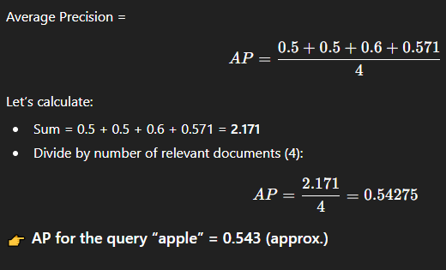
15 Step 2 — Compute Average Precision (AP)

Slide 41
15 compute MAP across multiple queries
Query | AP
apple | 0.543
banana | 0.700
fruit | 0.400

Slide 42
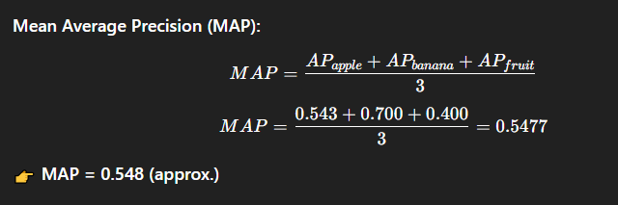
15 Mean Average Precision (MAP)

Slide 43
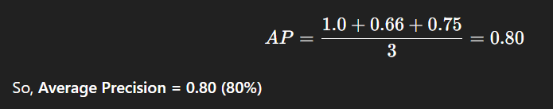
15 Formula- Application

Slide 44
15 Mean Average Precision (MAP)
MAP is the mean of the Average Precision (AP) values over multiple queries.
Used when evaluating the performance of an IR system across many search queries.
More reliable metric for real-world systems than AP alone.

Slide 45
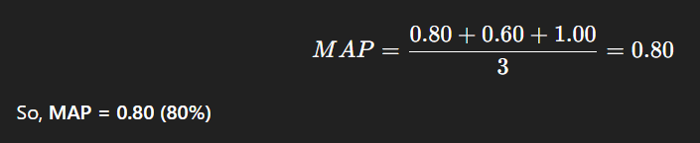
15 Example Table
Suppose you run 3 queries in a search system:
Query | AP
Q1 | 0.80
Q2 | 0.60
Q3 | 1.00

Slide 46
15 Precision at k (P@k) & R-Precision
Measures precision among the top k retrieved documents
Important because users usually look only at the first few results
Common values of k: P@5, P@10, P@20

Slide 47
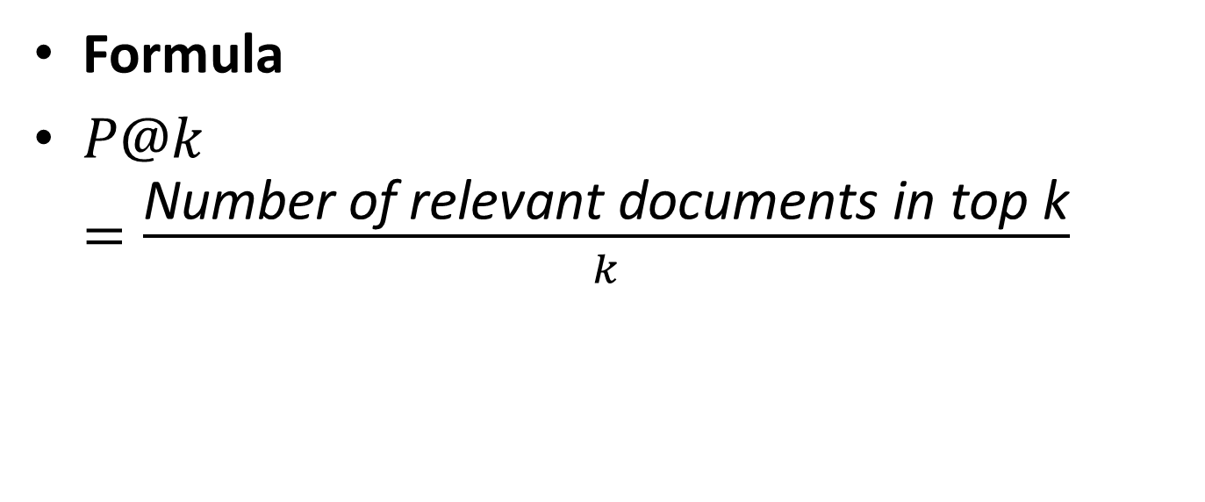
15 Precision at k (P@k) & R-Precision - Formula
Formula
$P@k=\frac{\text{Number} \text{of} \text{relevant} \text{documents} \text{in} \text{top} \text{k}}{k}$

Slide 48
15 Example - Precision at k (P@k) & R-Precision
For a query, the system retrieved first 10 documents, and 6 of them are relevant:
P@k = 6/10 = 0.6 (60%)

Slide 49
15 Why P@k is Useful?
Evaluates ranking quality at the top
Used in search engines, YouTube recommendations, e-commerce

Slide 50
15 R-Precision
Precision calculated at R, where R = number of total relevant documents in the collection for that query.
Example: If database has 20 relevant documents, then evaluate precision at rank 20

Slide 51
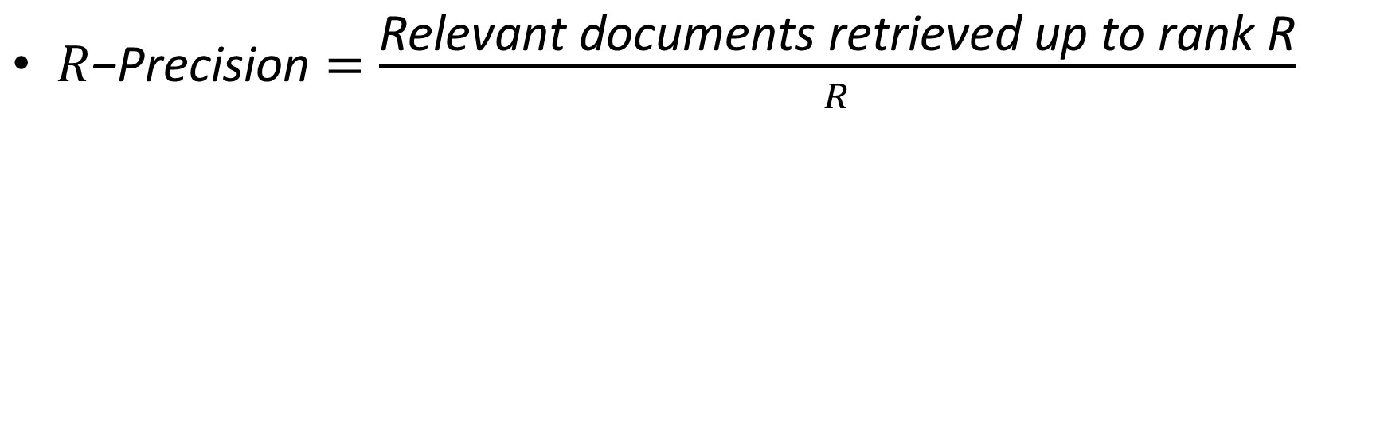
15 R-Precision Formula
$R\text{−}\text{Precision}=\frac{\text{Relevant} \text{documents} \text{retrieved} \text{up} \text{to} \text{rank} \text{R}}{R}$

Slide 52
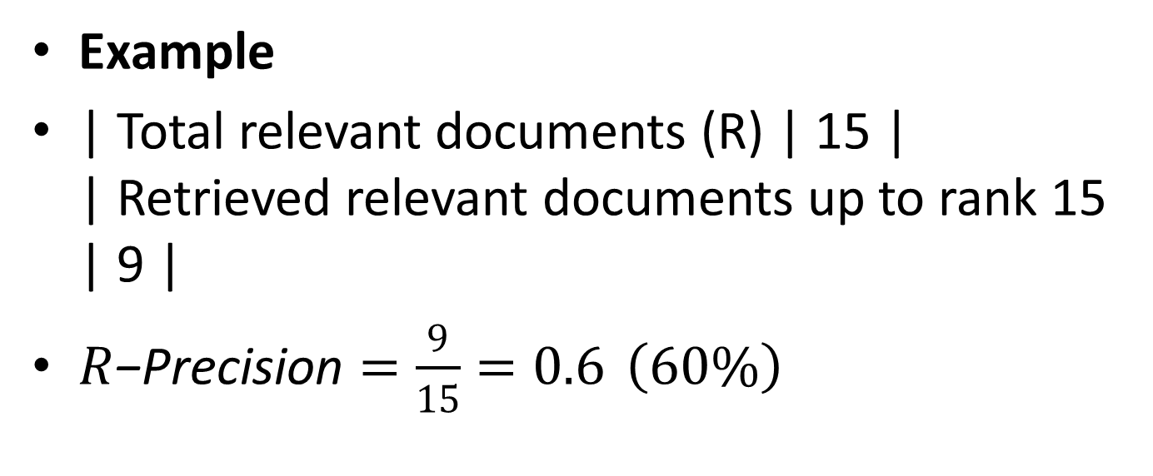
15 R-Precision
Example
| Total relevant documents (R) | 15 | | Retrieved relevant documents up to rank 15 | 9 |
$R\text{−}\text{Precision}=\frac{9}{15}=0.6 \left(60\%\right)$

Slide 53
15 Key Difference
Metric | Focus
P@k | Precision in top k results
R-Precision | Precision at total number of relevant docs

Slide 54
15 Test Collections
A test collection is a dataset used to evaluate and compare Information Retrieval systems.
It provides a standardized environment for testing.
Contains three main components:
Documents – the full database to search
Queries – user requests or search inputs
Relevance Judgments – specify which documents are relevant to each query

Slide 55
15 Examples of Popular Test Collections
Collection | Description
Cranfield | Classic IR test collection
TREC | Large evaluation conference dataset
CLEF | Cross-language evaluation
NTCIR | Asian language IR
MS MARCO | Web search evaluation

Slide 56
15 What are Relevance Judgments?
They are the “right answers” in an information retrieval system.
Determine whether a document is useful for a given query or information need.
Binary decision:
Relevant → document helps answer the information need
Not relevant → document doesn’t help
Even if a small part of the document is relevant, the document is considered relevant.

Slide 57
15 Test collection consists of:
Document collection
Queries (information needs)
Relevance judgments (Qrels)
Must ensure Qrels match the document collection when testing retrieval results.

Slide 58
15 How Relevance Judgments Are Made – Pooling Technique
1. Pooling Technique
Used to decide which documents to judge for relevance in large collections.
Steps:
Run multiple IR systems on the same query.
Take the top results from each system and combine them into a “pool.”
Human judges examine only these pooled documents.
This ensures most of the relevant documents are likely included, without judging the entire collection.

Slide 59
15 How Relevance Judgments Are Made – Pooling Technique
2. Completeness
The relevance judgments are considered “complete” for that particular set of documents.
“Complete” means enough results have been judged so that most relevant documents have been found.

Slide 60
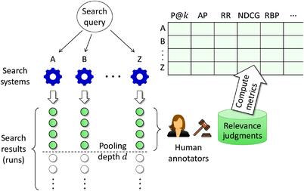

Slide 61
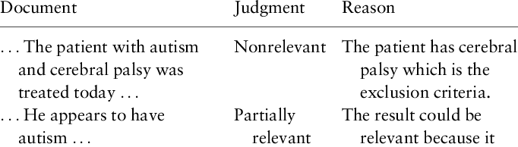

Slide 62
15 Experimental Design in IR Evaluation
To compare IR systems fairly and understand if observed differences are meaningful.
1. Separate Development and Test Sets
2. Random Sampling of Queries
3. Repeated Experiments

Slide 63
15 Significance Testing
To determine if differences in performance metrics (precision, recall, MAP) between systems are statistically meaningful.
Avoid drawing conclusions from random variations in results.

Slide 64
15 Common Tests Significance Testing
t-test: Compare mean performance of two systems.
Wilcoxon signed-rank test: Non-parametric alternative for paired comparisons.
ANOVA: Compare multiple systems simultaneously.

Slide 65

Thank you…
“If spelling errors cause mismatches and confusion in search, what can an IR system do to still understand the user’s intended word?”

